Slide 1
DATATHON 2023 HBV INFECTION RISK PREDICTION - Kirtikanth - Deepika - Jithendar - Madhukar Reddy

Slide 2
Data Extraction
NHANES 2001-2018 data – 9 cycles – Only Considered Data where Vaccination Status is Unknown or “No”.
Variables that could be collected from a general doctor visit.
Types of Variables:
Demographic Data: Gender, Age, Race/Ethnicity, Veteran Status, Birth country, Citizenship Status, Education level, Marital Status, Income/Poverty Ratio.
Questionnaire Data : Insurance, Alcohol Intake, Healthcare Access, Dialysis, Liver Condition, Blood Transfusion, Hepatitits C.
Laboratory Data: ALT, AST, Albumin, Platelet count.
Response Variable : Surface Antigen is Positive OR Hepatitis B ever told: No

Slide 3
Data Pre-processing
01
Missing Value Imputation :
Removed features where Missing Value % is very high.
Removed the entries with less missing values %.
Continuous Variables(ALT,AST,PCT) are imputed with median as the distributions are highly skewed to the right.
Income to Poverty ratio is imputed with the weighted average of the PSU-STRATUM combination
Data Merging :
Data Preprocessing has been done separately for all the cycles.
Concatenated all the data sets from 2001 – 2018 post data pre-processing.
02

Slide 4
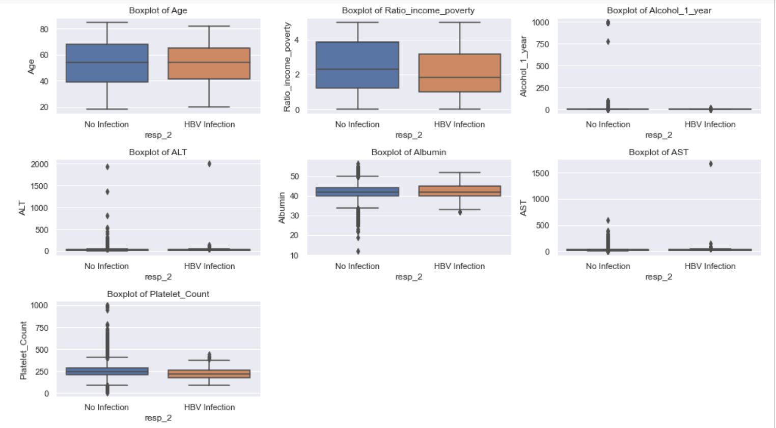
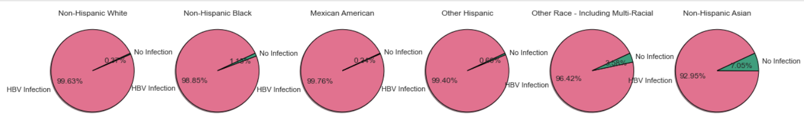
Exploratory Data Analysis
Box plots for continuous Variables for the two classes. Inclusion of outliers gave erroneous results Removed the outliers Highly Imbalanced Data 0.82% of Infections out of the entire data

Slide 5
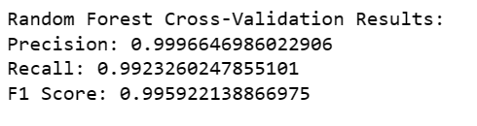
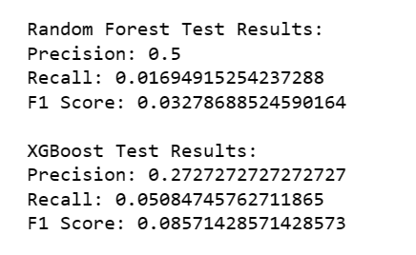
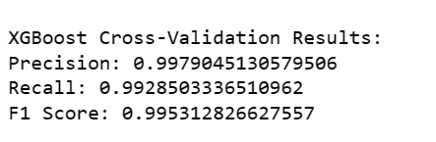
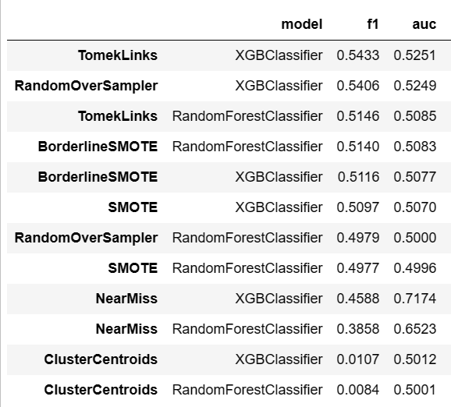
Techniques to account Data Imbalance
Phase 1: XG Boost and Random Forest Classifiers with Border line SMOTE
Models trained with the default Hyper Parameters
Highly Overfitted model – No regularization
Phase 2: XG Boost and Random Forest Classifiers with multiple sampling techniques
Random Over Sampler, SMOTE, Borderline SMOTE, Cluster Centroids, Tomek Links, Near Miss
Random search CV for selecting the best hyper parameters from the grid.

Slide 6
Model building and Selection
Model training and selection:
Chosen Near Miss under sampling technique as it has the best AUC scores and is more relevant to the context of the study.
Lot of Hyper parameter tuning to get the best AUC scores.
Final model parameters
XG Boost Classifier:
Random Forest Classifier: Number of trees: 550, Minimum samples Split: 10

Slide 7
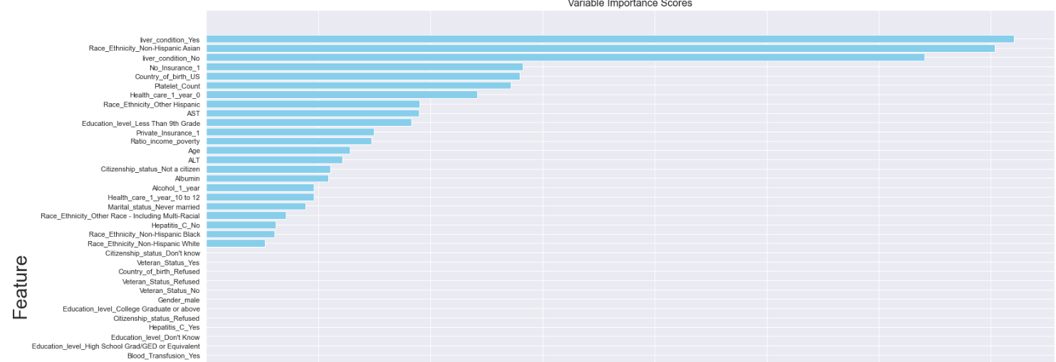
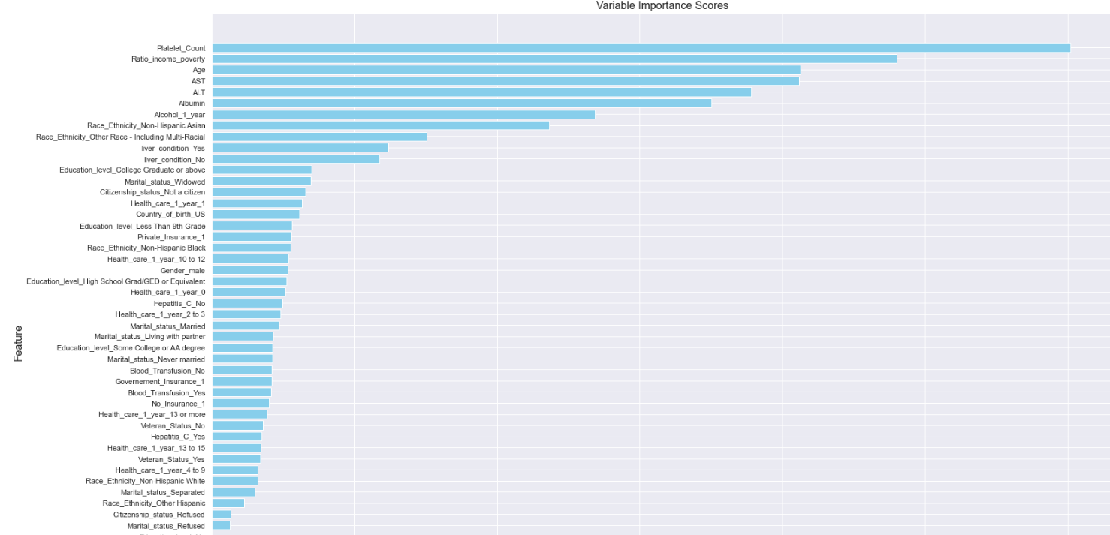
Variable Importances
XG Boost Classifier:
Random Forest Classifier:

Slide 8
Results and Recommendations :
Insights and Conclusion:
This case study applied machine learning algorithms to predict the risk of HBV infection for each participant based on health and demographic data, and evaluated the predictive effects for the models.
Our findings revealed that Near Miss sample preprocessing and the XG Boost algorithm together can be used for disease risk prediction with decent classification accuracy, which could better assist clinical decision making and treatment
Another model with Near Miss sample preprocessing and the Random Forest Classifier can also be used if there is a higher scope to collect more variables.
Recommendations and Way forward:
From the Variable importance scores, it is recommended to look for the variables such as awareness of liver condition, Non Hispanic Asian populations, high ALT/AST/Platelet count, Lack of insurance/ lesser healthcare access, Age.
We would want to do more hyper parameter tuning and check if the AUC scores increases, explore more variables, discuss with domain experts and incorporate those into the existing models.

Slide 9
References
Chronic Hepatitis B Prevalence Among Foreign-Born and U.S.-Born Adults in the United States, 1999-2016
https://wwwn.cdc.gov/nchs/nhanes/continuousnhanes/default.aspx?BeginYear=2017
Screening and Testing for Hepatitis B Virus Infection: CDC Recommendations — United States, 2023
Using Over-Sampling Techniques for Extremely Imbalanced Data

